Slide 1


BUSY BEAVER PROBLEM
By
Dr. Anat Paskin Cherniavsky
Or Gamliel
Ariel University
computer science department
08/06/2021

Slide 2
תכנית
פתיח
הצגת הפוסטר
מה זה הבונה העסוק?
ההתקדמות בבעיה עד כה
מסקנות
סיכום

Slide 3
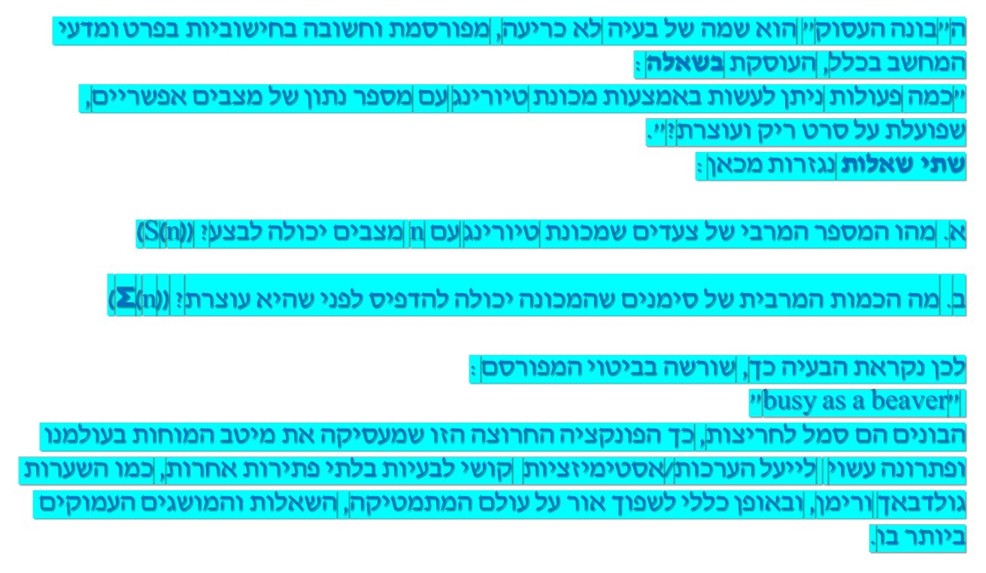
פתיח:

Slide 4
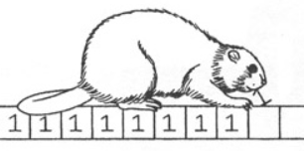
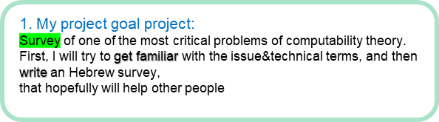
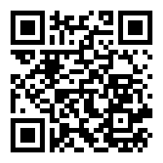
Busy Beaver Project
Presenter: Or Gamliel
Instructor: Dr Anat Paskin Cherniavsky
הצגת הפוסטר
2. Introduction:
In the project, we are trying to proceed on one of the open issues on this subject or thinking of new problem by ourselves.
We will need to understand the problem,
writing it and describing it correctly.
organizing, arranging and properly translating all the rare articles to fluent Hebrew, will be a decent task.
3. Methods/algorithms/Alternatives or Design Considerations:
Our way to go will be to read, understand and summarize professional articles on the subject.
Focusing&Expanding a sub-problem derived from the BB problem.
Create a glossary for all the many phrases we come across.
Creating quality information in Hebrew on an important scientific topic that is always good to move forward in it.
4. Our approach began with the summary of the article
“The 8000th Busy Beaver number eludes ZF set theory” by Scott Aaronson and Adam Yedidia.
5. Solution Description (Algorithms, Modulation, Patterns, Infrastructure, UI, Functionality)
Algorithms – read, understand and summarize professional articles.
Watching lectures dealing with the problem and analyzing them.
Modulation – The critical component will be the modulation of the translation of qualitative information into Hebrew in a way that preserves the understanding and clarity of the research.
Infrastructure – Our infrastructure will include:
Introduction, description of the problem, problems derived from it, possible solutions, conclusions and summary
Of course, in "Running Time" we can add new topics that will interest us.
UI – A comprehensive academic article on this important issue.
Functionality – It’s almost easy to see the practicality that can come out in accessible and relatively rare information in this issue that has been published in the form of an article.
Students will be able to use it in their studies, curious people will be able to learn new things from it and maybe we will find ideas (achievable or imaginary) that can advance the discourse on this topic.
Scan QRCode for full Instructions

Slide 5
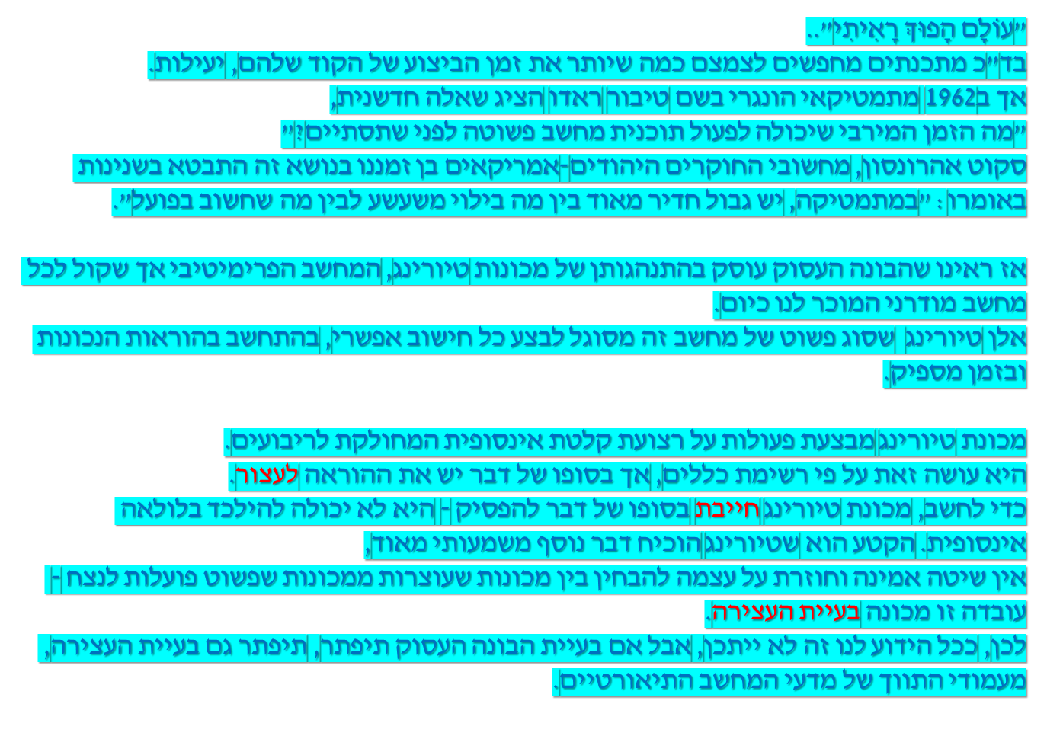
מה זה הבונה העסוק?

Slide 6
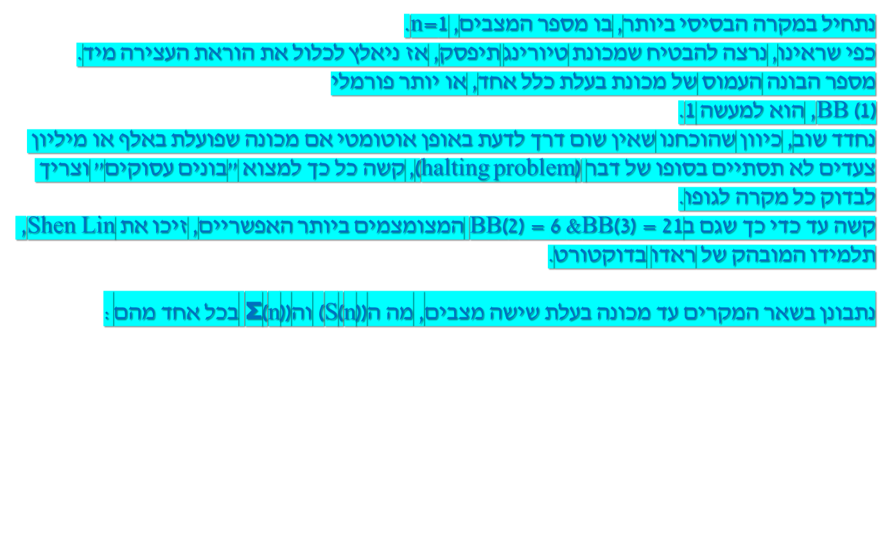
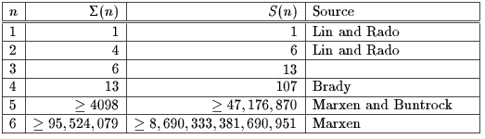
ההתקדמות בבעיה עד כה

Slide 7
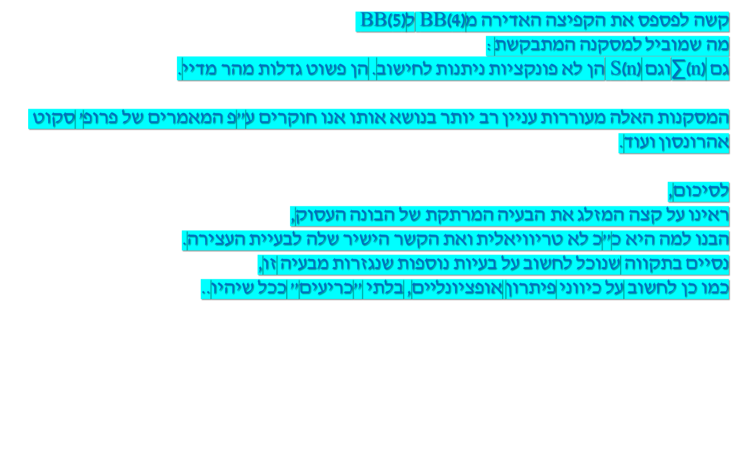
מסקנות וסיכום

Slide 8
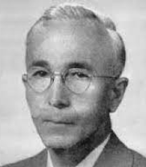
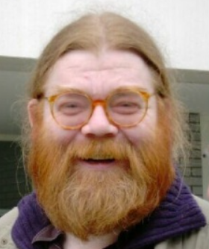

אישים מכריעים
Tibor Radó הוגה הבעיה
Heiner Marxen
∑(5) and ∑(6) חישב את
הבונה העסוק..

Slide 9
תודה רבה!

